Slide 1
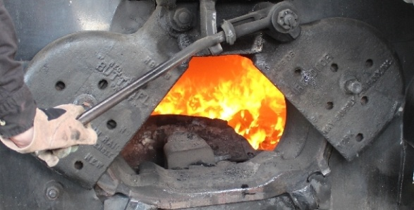

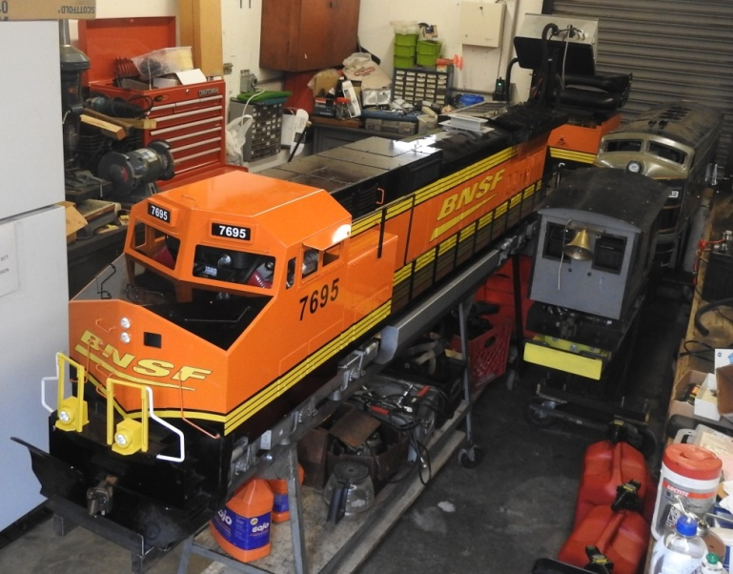
The
FIREBOX
Official Newsletter of the
Carillon Park Rail & Steam Society
1000 Carillon Blvd, Dayton, Ohio 45409 www.CPRSS.org
Jan 03, 2021
Upcoming Events:
1 ) There will NOT be a CPR&SS Train Club meeting in January 2021.
Next meeting would be Feb 13 at 11 AM in the Carillon Park main building (address above).
2 ) Rail Festival committee meeting – no date set yet. See RailFestival.com for the latest info.
3) 1st 2021 train run – Not firm but probably April 10 from 1 – 4 PM, after CPR&SS meeting.
Next CPR&SS meeting discussions: Plans and schedule for 2021, COVID impacts, work days, train storage, Carillon park plans, Rail Festival, etc.
Members: Club memberships EXPIRE on March 31, 2021. You MUST be a member to run ANY equipment at the track. For memberships, sign up at the track or send an email to: Larry Wassell, Reilmann6240@att.net or postal mail to 2824 Vale Dr., Kettering OH 45420. For info also see the Membership page at: www.CPRSS.org
CPR & SS 2020/21 Officers(*) and others:
*President: Jim Eaton 812-603-6275
Jim.Eaton@CPRSS.org
*Vice President: Norm Gibson
937-510-6142 NormGibson2015@gmail.com
*Treasurer: Bob Schwenke 937-572-3411
RBSchwenke50@AOL.com
*Secretary: Ken Hemmelgarn 937-275-9589 Ken.Hemmelgarn@sbcglobal.net
Membership, Engine Maintenance,
& Special Runs: Lawrence Wassell
937-293-3615 Reilmann6240@att.net
Safety Committee: Mike Harbaugh
Boiler Inspections: Ken Hemmelgarn
937-275-9589 Ken.Hemmelgarn@sbcglobal.net
Newsletter, Website, Volunteer Hours:
John Laugle (937) 269-4654 jwlaugle@yahoo.com
Above is the engine house on Dec 27, 2020 showing the CPR&SS’s newest engine, 7695, a little after its one year anniversary. On the right is the club’s Plum Cove and behind it is 1932, an F7 type in B&O paint scheme.

Slide 2
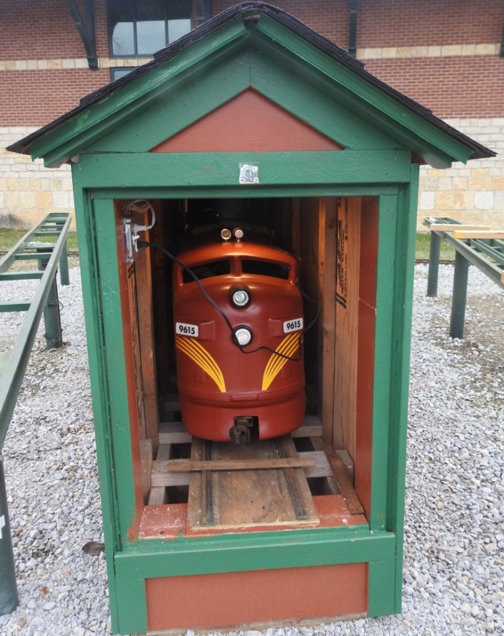
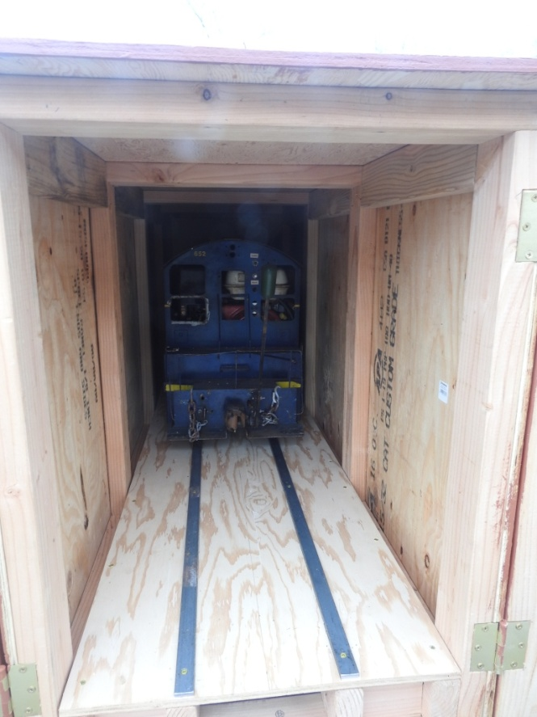
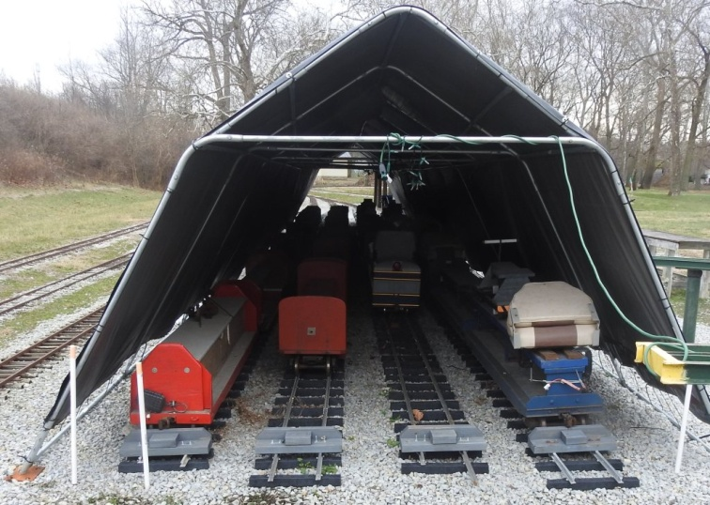
There were no train runs in November or December to provide pictures from so here are pictures from around the track. Most pictures were taken on Dec 27, 2020.
Jan 2021
Below left is club loco 9615A which was painted in a Pennsy color scheme by Bob S over the summer. It was previously numbered 615 and was red. Bob also built an engineer’s car which is stored behind 9615A in this storage unit. Numbered 9615B, it is also painted in matching Pennsy colors. The battery charger’s black cord crosses over the loco’s face in this picture. This storage unit is 15.5 feet deep and allows the loco and engineer’s car to be stored as one unit.
Above right is club loco 652 tucked back in the second storage unit. This unit was built to provide a more weather-proof location for 652 which had been stored in the hillside tunnel which still allowed rain and snow to be blown onto the engine. This unit is 8 feet deep with provision to extend it another 8 feet so a loco and engineer’s car can be stored as one unit.
At left is the tarp tunnel’s west end. This is where the club stores its passenger cars, conductor cars, and other miscellaneous cars. Both ends are open which exposes cars inside to some weathering. Plus the tarps have been replaced 3 or 4 times already due to their deterioration and ripping. Better, more weather resistant storage is a long term goal.

Slide 3
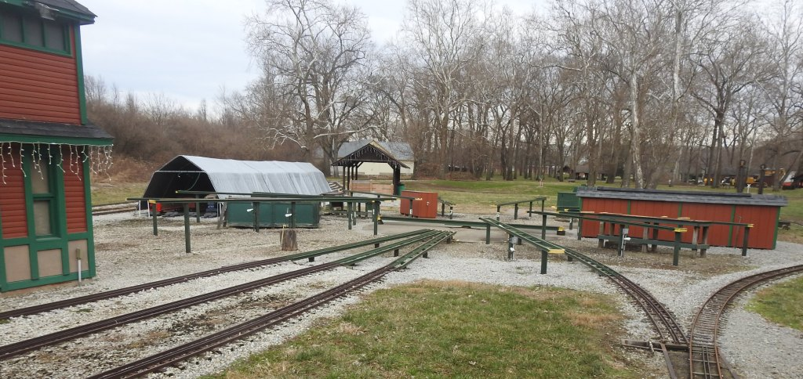
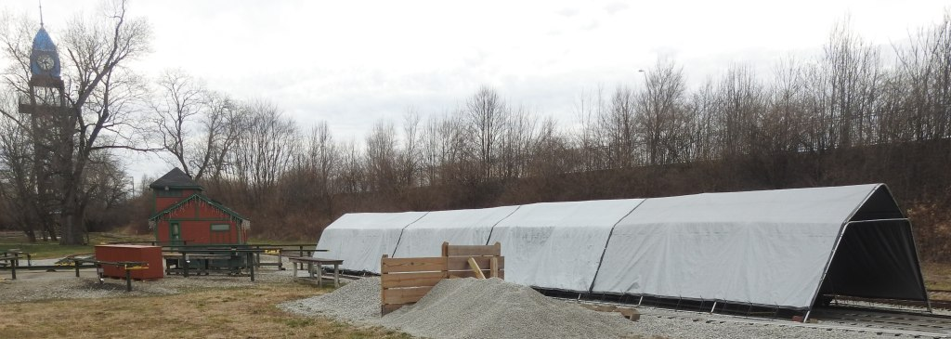
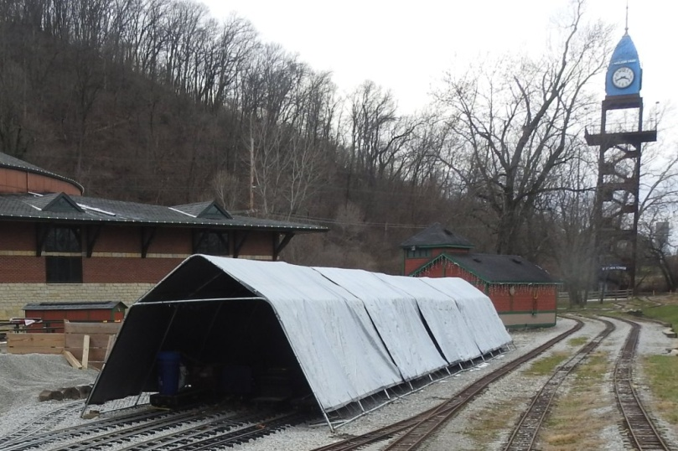
Jan 2021
The pictures on this page were also taken on Dec 27, 2020 and show various views around the track. Below is a view through the steaming bay area with the two storage units built this summer and fall – thanks to all who helped with the build.
Above and at right are two views of the tarp tunnel showing it is still there and there are no ripped tarps at this point. The last time these were replaced, they were replaced with heavier material tarps and they were placed right over the previous tarps giving it added thickness. They seem to be holding at this point. They too will most likely need replacing this year.

Slide 4
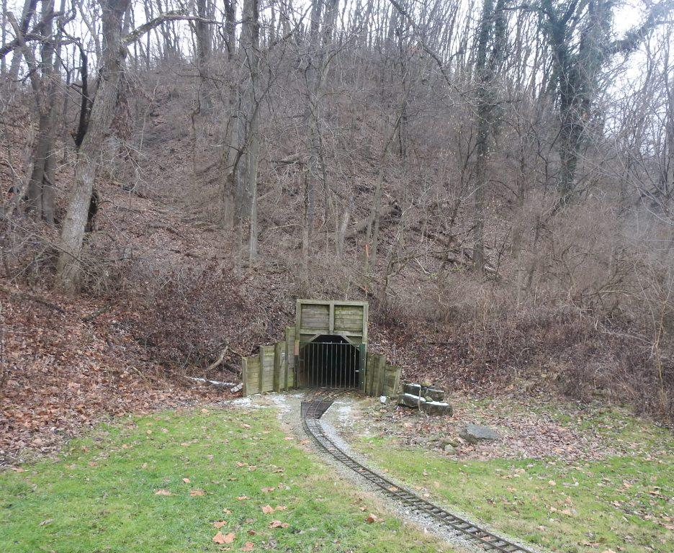
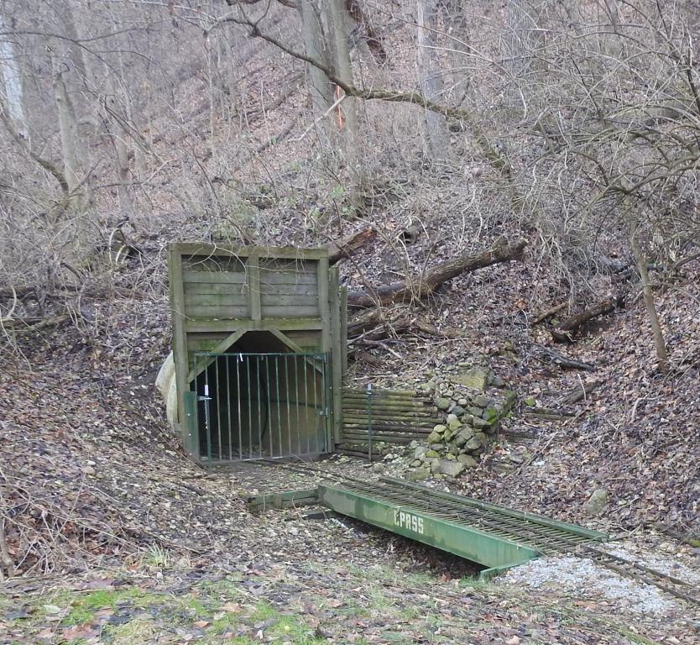
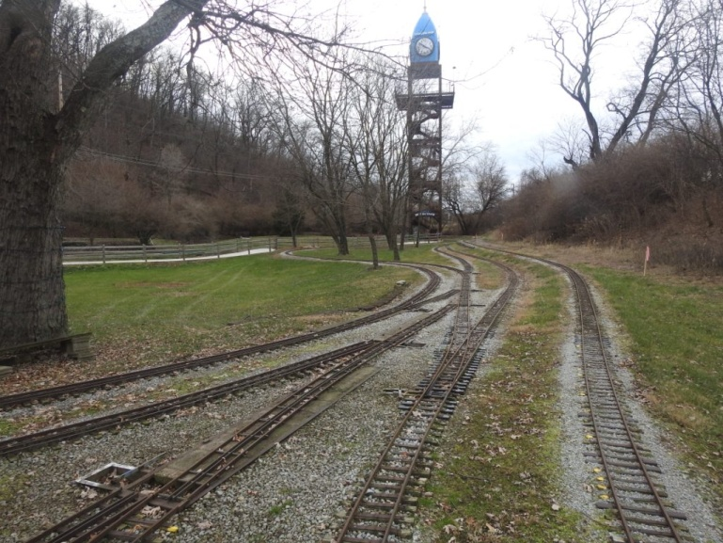
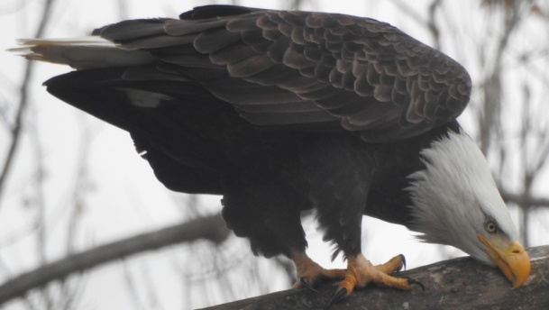
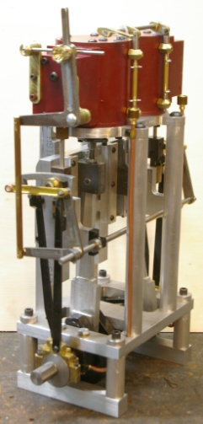
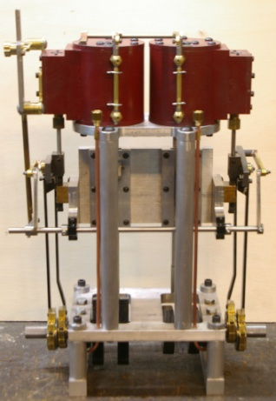
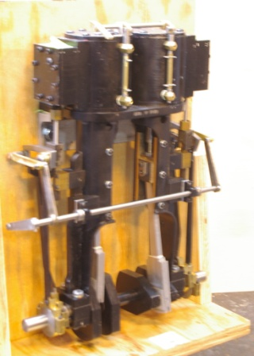
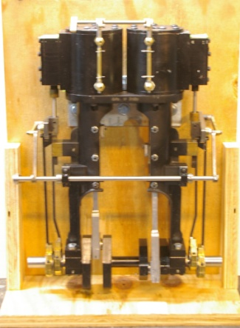
Jan 2021
Below is the hill side tunnel, east end on the left and west end on the right. In the left picture, you can see how high the hill is since all the leaves have fallen. Dec 27, 2020.
Eagle Update: Above is the female, Willa, on Dec 27, 2020 cleaning her beak against a branch after just finishing off a fish. The male, Orv, is also around and both have been building onto their nest. The first egg is expected in March.
View looking west from the engine house. The tracks seem to be in good shape so far this winter.
Below are pictures from Ken H. He says he just finished 3 Mich-Cal #2 vertical engines. One is made up as a launch engine.

Slide 5
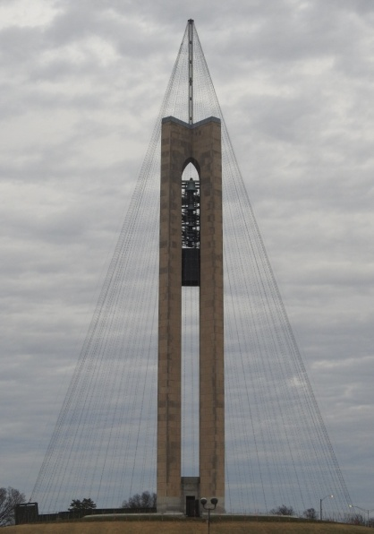
Jan 2021
The Feb CPR&SS club meeting is scheduled for Saturday, Feb 13, 2021 starting PROMPTLY at 11 AM. The meeting is planned to be in the Carillon Park main building which is also known as the Kettering building. You should come in through the main entrance. Masks must be worn while inside the park. See DaytonHistory.org for details.
At right is the Carillon tower on Dec 27, 2020, before the lights were turned on. It shows the tower extension added on top to support the 100 cables which hold 200 lights each for a total of 20000 lights. The holiday event at the park was called A Carillon Christmas and operated from Nov 24 through Dec 30, 2020. The CPR&SS train club did not run trains during the event, as they did in past years, due to concerns for its members from the COVID-19 virus. Hopefully, the CPR&SS trains will run again during the 2021 Carillon Christmas event.
Miscellaneous links: Check for coronavirus updates on each website as things can change quickly. Many sites below have not been updated to show their 2021 events. Check sites often for updates.
Mill Creek Central: Volunteer Spring Work & Run is May 14-16, 2021. Buckeye Limited moved to 2022.
FortWayneRailRoad.org Cincinnati Cinder Sniffers Indiana Live Steamers
Age Of Steam Roundhouse Tours scheduled to resume in May 2021. Check their website or call.
Lebanon Railroad Dayton Train Show - Scheduled for Nov 6 & 7, 2021, at Montgomery Co. Fairgrounds.
LAKE FOREST LIVE STEAMERS RAILWAY MUSEUM ←Track, Wheel, Data & Drawings & more.
UP.com/heritage/steam/
LiveSteam.Net Live Steam & Outdoor Railroading magazine – Articles, vendors, other clubs and schedules.
DiscoverLiveSteam.com/ Live steam and diesel model RR – Locos & items for sale, vendors, articles, etc.

Slide 6
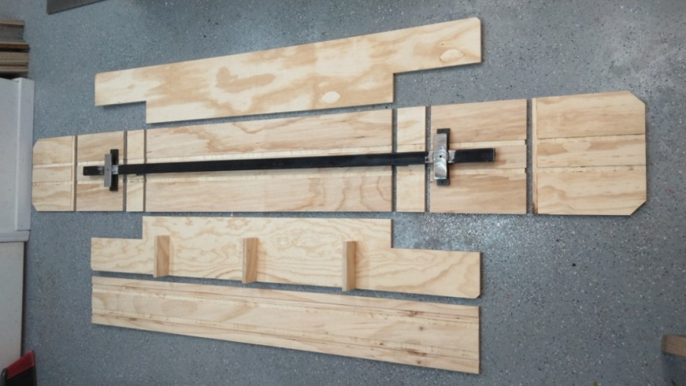
Shown below is the preliminary train run schedule for 2021. Note that it is preliminary and may change or some runs be canceled. Check the CPRSS.org website as each run day approaches for possible changes.
2021 Preliminary Train Run Schedule
April 10, 1 – 4 PM, Saturday
April 24, 1 – 4 PM, Saturday
May 8, 1 – 4 PM, Saturday
Heritage Day, May 30 , 11 AM – 7 PM, Sunday
Rail Festival, June 26, 9:30 – 5 PM, Saturday
Rail Festival, June 27, 11 AM – 4 PM, Sunday
July 10, 1 – 4 PM, Saturday
July 24, 1 – 4 PM, Saturday
August 14, 1 – 4 PM, Saturday
August 28, 1 – 4 PM, Saturday
Labor Day, Sept 4, 1 – 4 PM, Saturday
Concours d'Elegance, Sept 19 11 AM – 4 PM, Sunday
October 9, 1 – 4 PM, Saturday
October 23, 1 – 4 PM, Saturday
Note: Some web links included above have not updated their website to show their new 2021 information. Please check them later for updates.
At right is a picture of a passenger car kit that has been prepared by Bob Schwenke. These are intended for use by the CPR&SS club to carry passengers during our train runs. They are not for sale. Kits include all the pieces shown in the picture plus assembly instructions, glue, and fasteners. Past kits needed to
be painted inside and out with Kilz paint to help reduce rotting. They then need to be painted in an exterior paint which will also be provided. Cars are 8 feet long so you will need an area 10 feet long by 4 feet or so for assembly. Bob is trying to have kits ready not later than the end of January. If a CPR&SS member is interested in taking on assembly of one, text or email Robert Schwenke: 937-572-3411 , rbschwenke50@aol.com. He will arrange pick up or delivery.

